Slide 1
Asset Allocation Excel Optimization

Slide 2
Pre-work
Download the stock price from websites such as finance.yahoo.com
Calculate the return: today’s return=today’s price/yesterday’s price – 1
Use excel Data Analysis tool to get
Descriptive statistics
Correlation

Slide 3
Step 1: Set up data
Replace your stocks' info to the existing data correspondingly
Name, mean, std, corr , std (the cells in the grey color, see Picture 1)
Choose the appropriate level of rf, the risk free rate
Based on your data frequency and market performance, you can make up a reasonable rf.
e.g., if you use weekly data, it’s hard to think the risk free rate in ONE WEEK is 3%. 0.0006 (=3%/52) might be a good estimate.

Slide 4
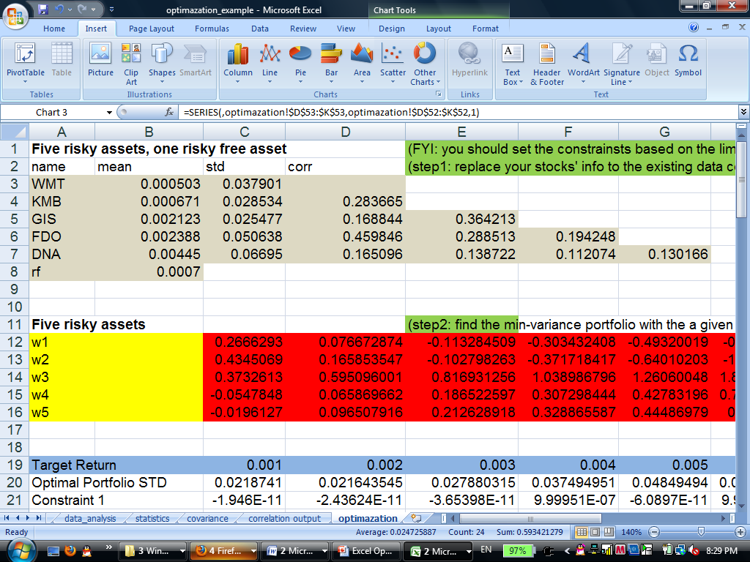
Step 1: Picture 1

Slide 5
Step2: Find the min-variance portfolio with the a given rate of return
Set up the reasonable target rates of return (Cell C19-H19).
You can make the range of the target returns as the range of your stock returns.
What is an unreasonable return?
For example, if the max return of your stock is 0.001, it’s not reasonable to set the target return to 0.01 (10 times larger than your stock return).

Slide 6
Step2: Find the min-variance portfolio for a given rate of return
Let’s try the target return of 0.001 (cell C19): given the rate of return=0.001, we want to allocate different weights to five stocks to get a portfolio, which has the lowest risk (std).
Give some initial weights to five stocks (C12-C16), e.g., 0.2 to each, equally weighted.
Solver tool (see Picture 2)
You will get the optimized weights for 5 stocks (see Picture 3).

Slide 7
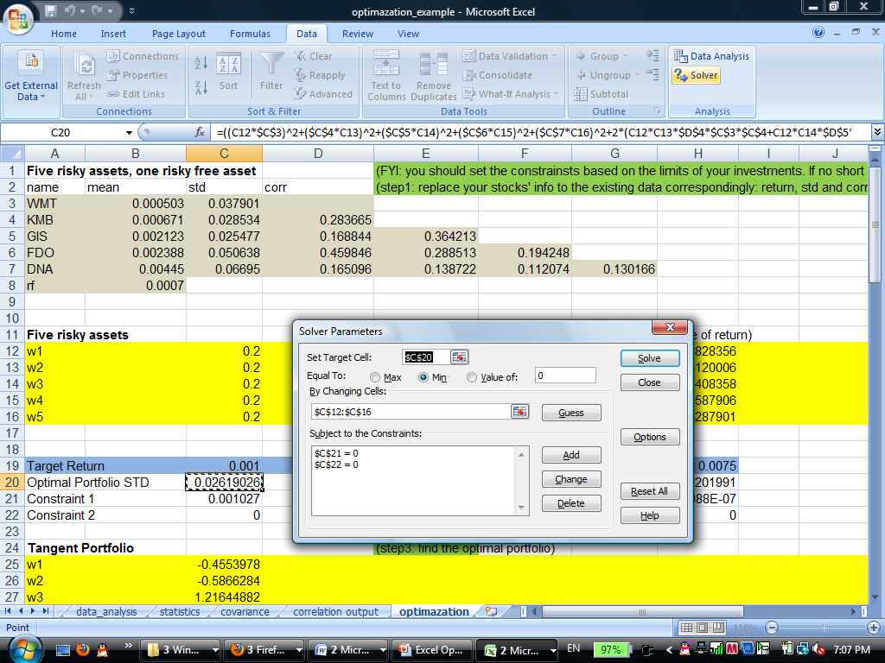
Step2: if the target return=0.001 Solver tool Picture 2

Slide 8
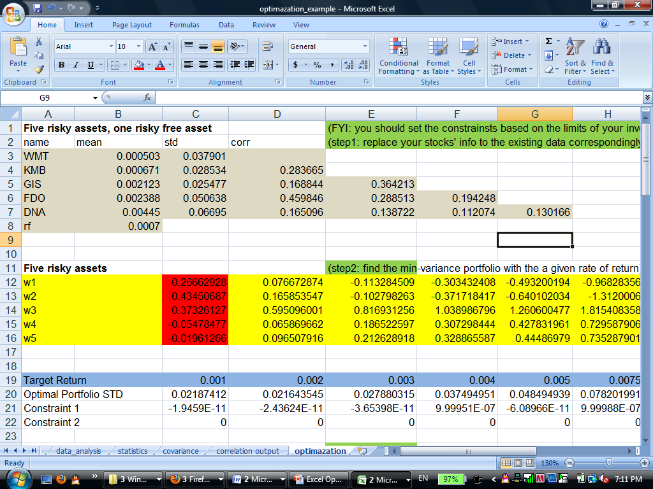
Step2: if the target return=0.001 Solver results Picture 3
Given target rate of return of 0.001
In the Solver tool, give inputs to
Set target cell
By changing cells
Subject to the constraints
The solver shows the optimized weights are: Cell C12 to C 16 (cells in the red color)

Slide 9
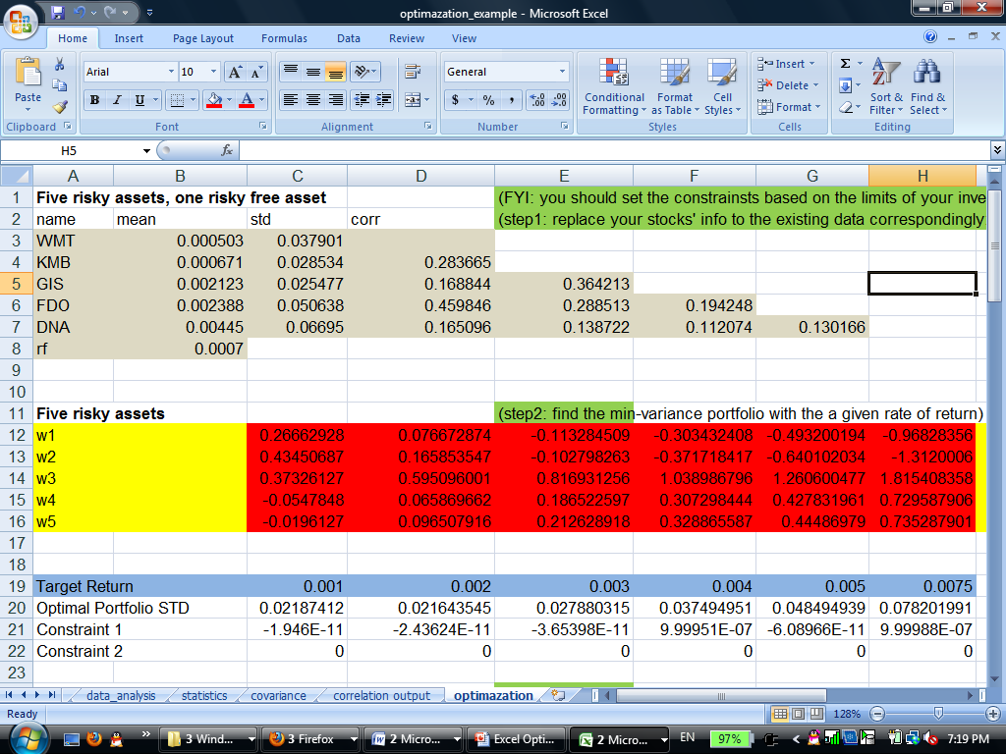
Step2: Find the min-variance portfolio for a given rate of return Picture 4
Repeat slide 6- slide 8, for the other FOUR target rates of return.
The results are shown the cells in read in the left picture (Picture 4)

Slide 10
Step 3: Find the optimal portfolio
The optimal portfolio is the one has the largest Sharpe ratio.
Give some initial weights to five stocks (C25-C29), e.g., 0.2 to each, equally weighted.
Solver tool (see Picture 5)
You will get the optimized weights for 5 stocks (see Picture 6).

Slide 11
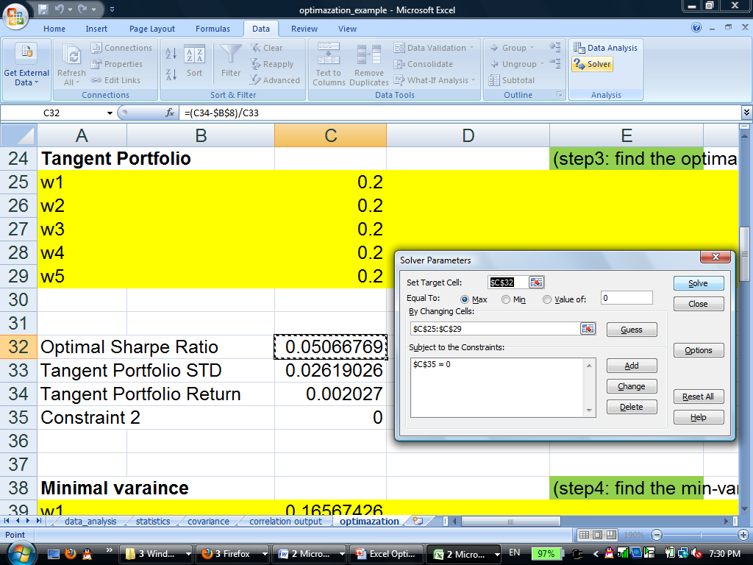
Step 3: Find the optimal portfolio Picture 5

Slide 12
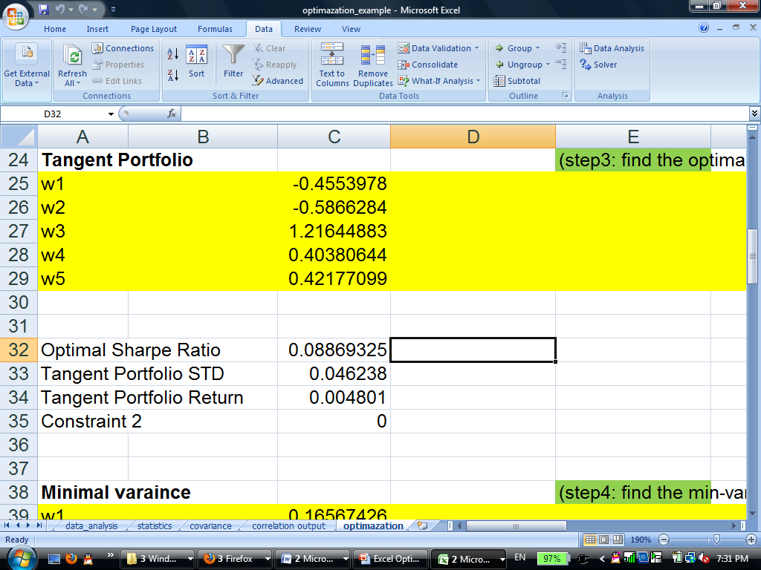
Step 3: Find the optimal portfolio Picture 6

Slide 13
Step 4: Find the Global Min Variance portfolio
The Global Min Variance portfolio is the one has the lowest risk (std).
Give some initial weights to five stocks (C39-C43), e.g., 0.2 to each, equally weighted.
Solver tool (see Picture 7)
You will get the optimized weights for 5 stocks (see Picture 8).

Slide 14
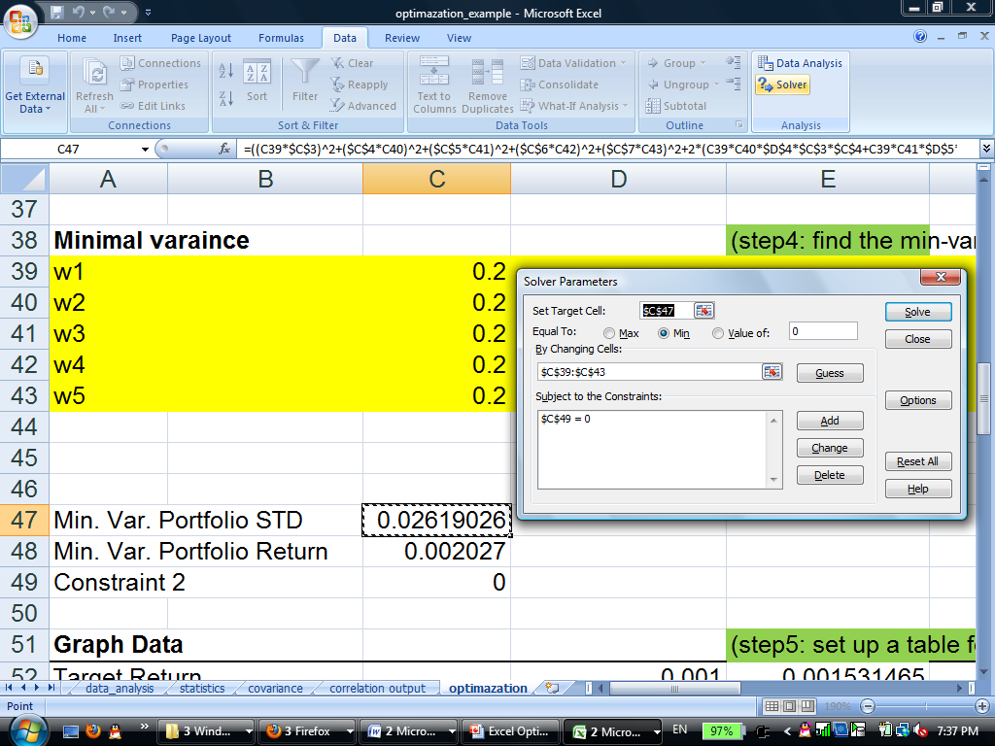
Step 4: Find the Global Min Variance portfolio Picture 7

Slide 15
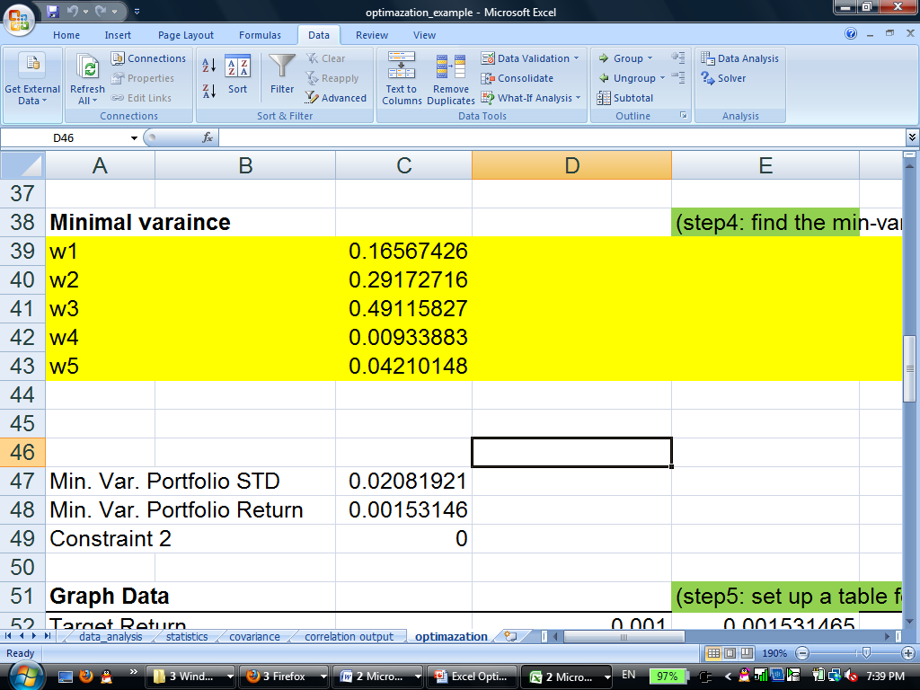
Step 4: Find the Global Min Variance portfolio Picture 8

Slide 16
Step5: Set up table for the graph
In the table of Graph Data, make sure the target returns have an ascending order.
Compare the returns from cell C19-H19 (six target returns), C34 (the optimal portfolio’s return) and C48 (the global min variable portfolio’s return)
Give them an ascending order in the table of Graph Data.
As long as your set the order of returns right, you will put the corresponding std (C20-H20, C33, and C47) to the row of Optimal Portfolio STD (Cell D53-K53)
The row of Efficient Frontier (D54-K54), by definition, is equal to: [Target return in the table – risk free rate ($B$8)] /the sharpe ratio ($C$32)

Slide 17
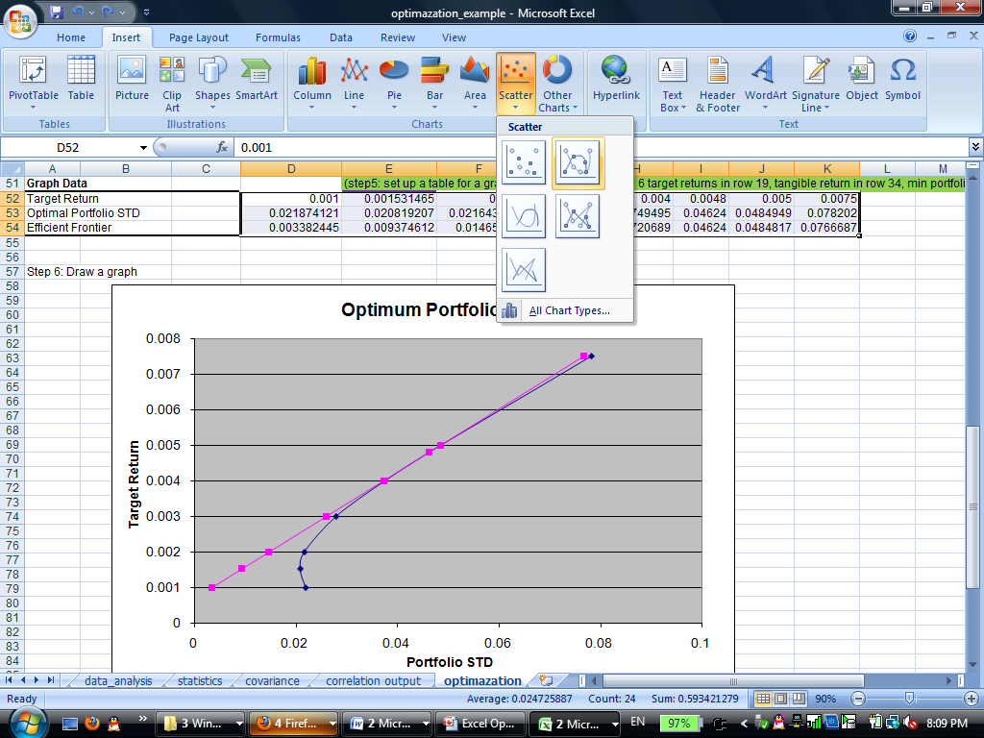
Step 6: Draw a graph Picture 9
Highlight cells D52 to K54.
Insert a chart: Scatter (Picture 9)
Draw two lines:
Line 1:
X: Optimal Portfolio STD
Y: target return
Line 2:
X: Efficient Frontier
Y: Target return

Slide 18
Some thoughts
Hopefully, you’ll get a nice graph and have done the ugliest work.
However, it’s very possible your optimal portfolio is located on the very far Northeast in the graph
The financial indication is: it’s very hard to get your optimal portfolio. You must heavily use leverage (weights are very big) to achieve the optimal level.
It’s the real life. We may put more constraints in Step 3 to find the optimal portfolio. Such as set the weights in the range of -1 and 1.

Slide 19
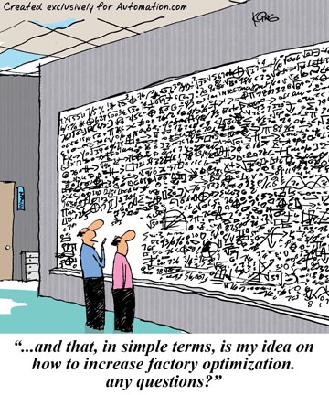
We are done!

